Slide 1
How did democratic ideals
and key documents
shape the development
of government in
the United States?

Slide 2
objective 8.1.2

Slide 3
The word “democracy” comes from the Greek words “demos” (people) and “kratos” (rule or authority).

Slide 4
The simplest definition of “democracy” is rule by the people

Slide 5
Today, the word refers to a government in which final authority is vested (owned by) the people.

Slide 6
The idea of “democracy” has NOT always been the same as it is today.

Slide 7
In this objective we will look at how the idea of “democracy” has GROWN and CHANGED over thousands of years.

Slide 8
Objective 1.2
Influences on the development of democratic ideals

Slide 9
def: influences
to guide or move by intellectual appeal

Slide 10
def: development
growing, expanding, evolving;
to bring to completeness

Slide 11
def: democratic
believing in the rights of people

Slide 12
def: ideals
a standard that embodies an idea of the highest attainable excellence

Slide 13
there were 4 major influences:
Athenian democracy
the Magna Carta
the English Bill of Rights
the Mayflower Compact

Slide 14
there were 4 major influences:
Athenian democracy
the Magna Carta
the English Bill of Rights
the Mayflower Compact

Slide 15
there were 4 major influences:
Definition of “major”:
BIG

Slide 16
there were 4 major influences:
Athenian democracy
the Magna Carta
the Mayflower Compact
the English Bill of Rights

Slide 17
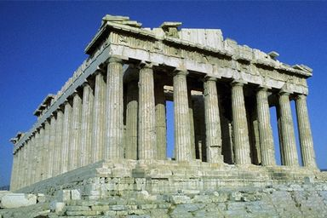

Slide 18
Athenian
democracy

Slide 19
Democracy started in (sometimes called “Athens”)
ancient Greece

Slide 20
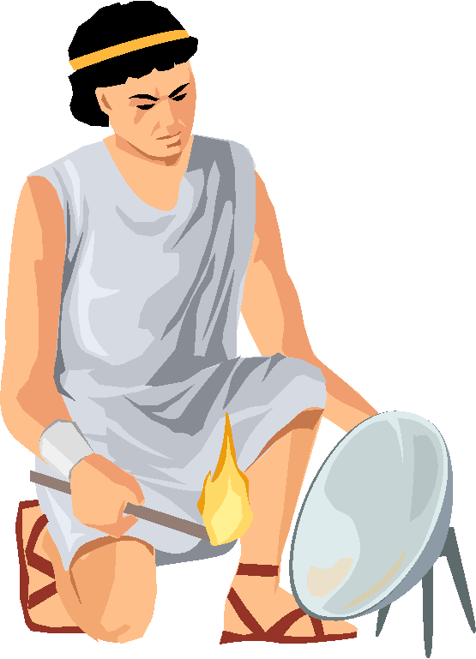
The origin (beginning) of “democracy”, like the word itself, goes back to ancient Greece.

Slide 21
As early as the 7th century B.C. Athens and other city-states were practicing simple forms of democracy.

Slide 22
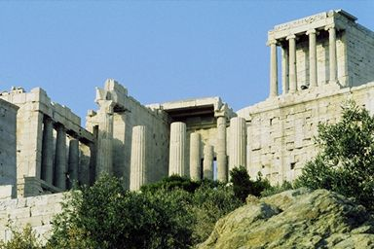

Slide 23
These early democracies were “direct” not “representative” like in the U.S. today.

Slide 24
All FREE MALE CITIZENS were eligible to become permanent members of the local assembly.

Slide 25
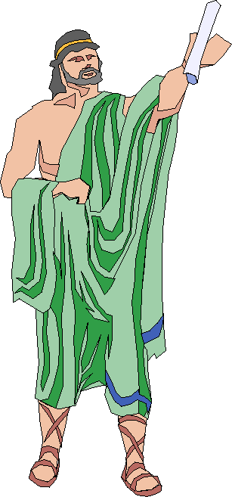
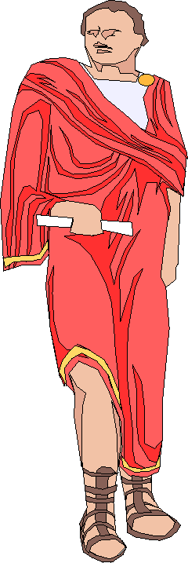
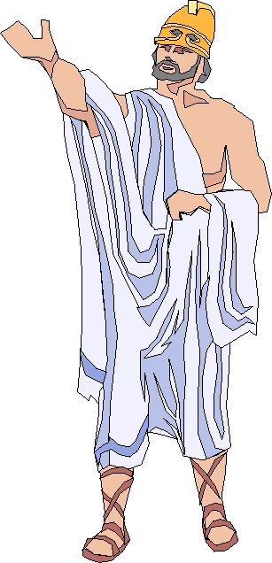

Slide 26
This entitled them to vote directly on important matters.

Slide 28
Magna
Carta

Slide 29
The next step in democracy happen during the (in England in Europe)
Middle Ages

Slide 30
Was there a re-birth of democracy during the Middle Ages?

Slide 31
In the Middle Ages a social system began that was called feudalism.

Slide 32
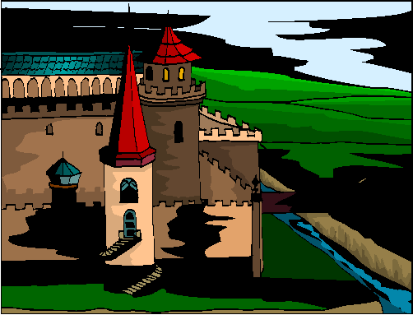

Slide 33
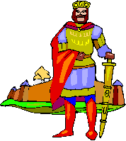
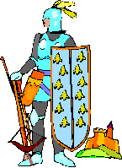
Under feudalism a group of people pledged their loyalty and service to a lord.

Slide 34
In return,the lord guaranteed certain rights and protections to those people (“subjects” or “vassals”).

Slide 35
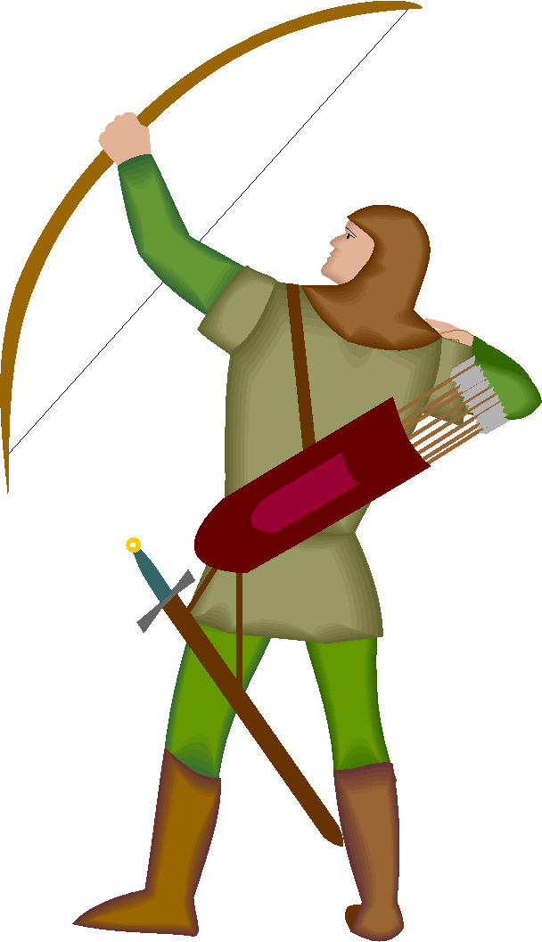

Slide 36
As a lord’s territory increased some forms of representative groups developed to help the lord maintain control.

Slide 37
Some of these groups were called “councils” or “assemblies”.

Slide 38
Democracy in England

Slide 39
The year is...
1215

Slide 40
The place: beside a river in…
England

Slide 41
The characters: a King of England and a group of his “nobles”.

Slide 42
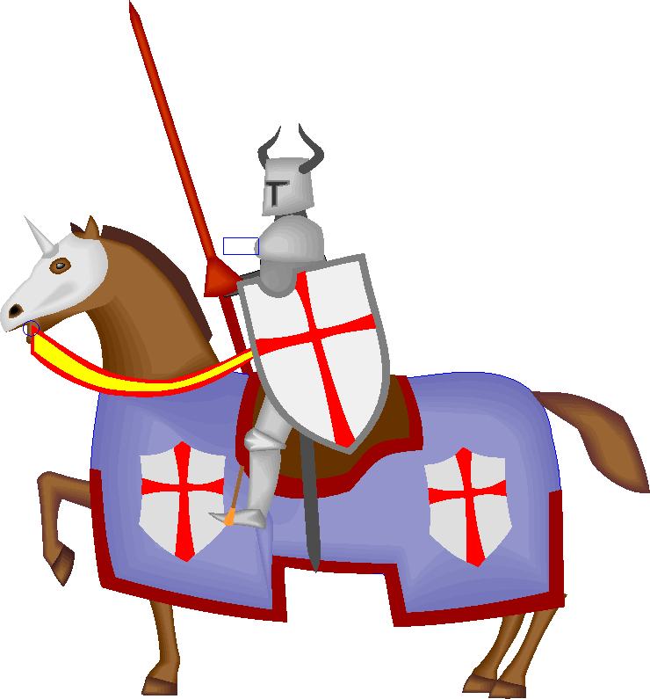

Slide 43
King John was forced by his nobles (his “council/assembly”) to sign a document called the “Magna Carta”.

Slide 44
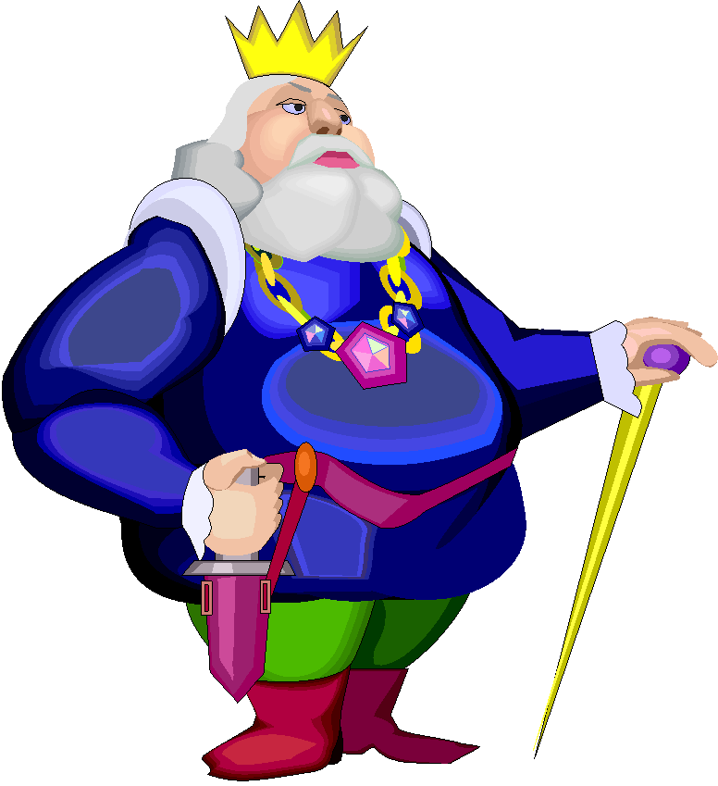

Slide 45
The Magna Carta granted civil liberties to the nobles
ONLY

Slide 46
The Magna Carta didn’t help the people who were NOT nobles.

Slide 47
The Magna Carta granted the following: no one jailed unfairly, fine must fit the crime, property couldn’t be taken, (widows didn’t have to remarry)

Slide 48
The Magna Carta established an important principle: the king must obey the law

Slide 49
The Magna Carta established an important principle: THE KING MUST OBEY THE LAW

Slide 50
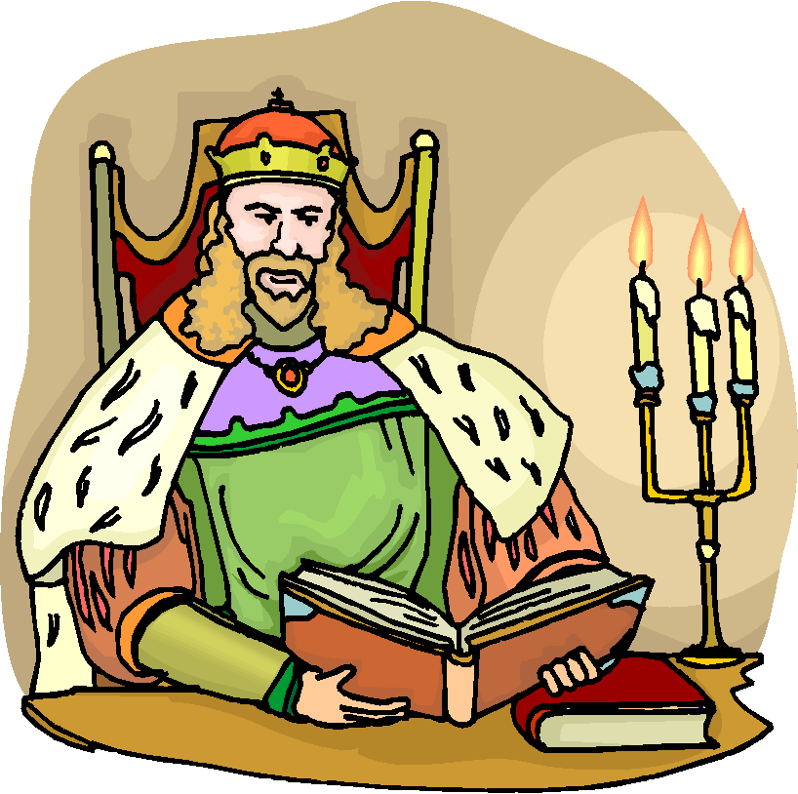

Slide 51
THE KING MUST OBEY THE LAW

Slide 52
The Magna Carta established an important principle: the power of the king had limits.

Slide 53
Because it also led to the nobles winning other personal freedoms it is considered one of the most important documents in the history of democracy.

Slide 54
The Magna Carta was the seed that (slowly) grew a huge plant called “democracy”

Slide 55
democracy

Slide 57
First Charter of Virginia

Slide 58
April 10,1606 written by the King of England

Slide 59
The First Charter of Virginia granted the London and the Plymouth Company to set up colonies in the New World

Slide 60
A BUSINESS Agreement that outlined a government

Slide 61
Payments, in the form of percentages from profits would be sent to the King

Slide 62
Liberties and rights equal to those in England

Slide 63
Still considered to be subjects of the King of England and were forced to follow his rules

Slide 64
Mayflower
Compact

Slide 65
Democracy arrives in America

Slide 66
The year is…
1620

Slide 67
A boat full of English men and women has sailed across the Atlantic Ocean and is approaching the “New World”.

Slide 68
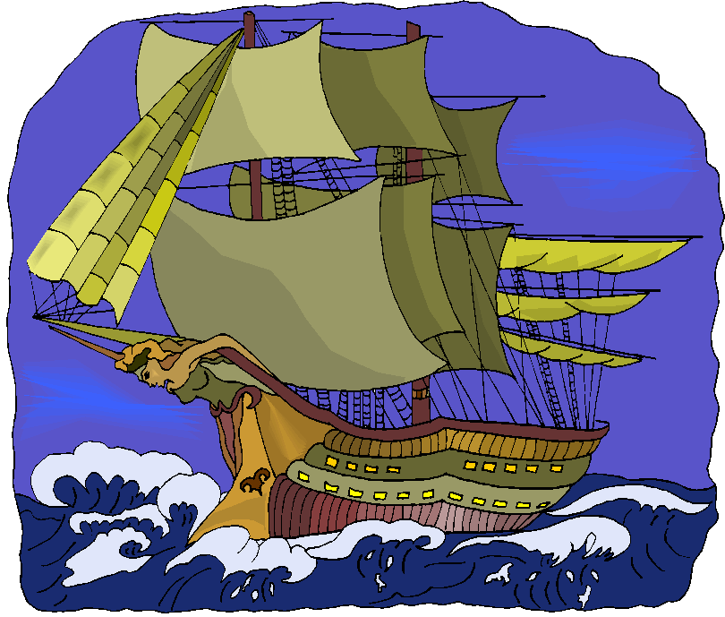

Slide 69
The boat arrives at land that was hundreds of miles north of Virginia in an area that is now the state of Massachusetts.

Slide 71
Before coming ashore, 41 of the settlers draw up a plan for government to run the colony.

Slide 72
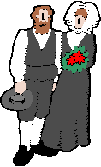

Slide 73
So, thousands of miles away from their king, with an ocean separating them, the settlers (not the king) decided on laws and chose leaders.

Slide 74
The document is called the “Mayflower Compact”.

Slide 75
Define “compact”: an agreement or contract made among a group of people. (compact = contract)

Slide 76
This “compact” said: the government would make “just and equal laws” for the good of the community.

Slide 77
The signers pledged to obey these laws. (the people promised to obey the laws)

Slide 78
The laws were voted on by all (adult) men and the majority ruled.

Slide 79
Because “all” voted on the laws, a “direct democracy” was created (sounds like Athens, huh!!!)

Slide 80
Today, many communities in this area still have “town meetings” where “direct democracy” is the form of government.

Slide 82
English
Bill of Rights

Slide 83
Democracy in England (continued) (26 years after Mayflower Compact)

Slide 84
the British (English) people and the king argued and had a civil war.

Slide 85
the British Parliament (like our Congress) finally became more powerful than the king. (the year is 1688)

Slide 86
The next year, Parliament passed the “Bill of Rights”,

Slide 87
The “Bill of Rights”, guaranteed fundamental civil liberties to all British citizens.

Slide 88
During the next three centuries (300 years) these rights were slowly expanded.

Slide 89
By 1928, all adult British citizens had the right to vote.

Slide 91
VIRGINIA DECLARATION OF RIGHTS

Slide 92
June 12,1776 written by George Mason

Slide 93
Guaranteed basic rights to Virginians:

Slide 94
(guaranteed) trial by jury, equal rights, no tax without consent, no cruel punishment

Slide 95
created a
three branch
government

Slide 96
was a model for the Bill of Rights of the U.S. Constitution
important
important

Slide 97
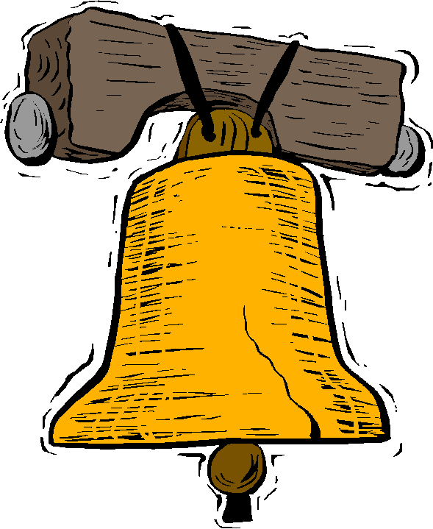
DECLARATION OF INDEPENDENCE

Slide 98
July 4, 1776 created by representatives of 13 colonies

Slide 99
Written by Thomas Jefferson

Slide 100
Stated grievances (complaints) against the of Great Britain

Slide 101
Declared colonies independent (free) from English rule

Slide 102
Affirmed “certain unalienable rights” Life, Liberty and Pursuit of Happiness

Slide 103
JOHN LOCKE said: Government derives (gets) power from the people

Slide 104
People have a right and duty to change a government that violates their rights

Slide 105
(Locke’s ideas) government has ONLY the powers people give it

Slide 106
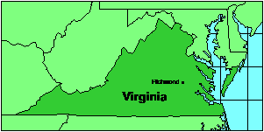
VIRGINIA CONSTITUTION

Slide 107
Virginia created a constitution in1776. It will be covered later.

Slide 108
ARTICLES OF CONFEDERATION

Slide 109
Written: 1777-1778 Lasted until 1787 (1789)

Slide 110
First U.S. government: ONE-HOUSE legislature

Slide 111
Weaknesses: could not enforce laws or tax. Had very limited powers

Slide 112
VIRGINIA STATUTE OF RELIGIOUS FREEDOM

Slide 113
1785 Written by Thomas Jefferson

Slide 114
Gave the “natural right” of religious freedom

Slide 115
that means: “freedom of religious beliefs and opinions”

Slide 116
Each citizen decides if wants to attend church (or not attend)

Slide 117
A citizen could not be deprived of religious beliefs

